Slide 1

Federated Learning
M.Sc. Semester III
Paper Code: CSMP-306
Session: 2025-26
Debottam Kar
CU Roll: C91/CSC/241011
Reg. No: 313-1111-0359-21

Slide 2
Introduction: What is Federated Learning?
Federated learning is a machine learning approach where multiple devices or organizations collaboratively train a shared model without sharing their raw data.
Instead of sending data to a central server, each participant:
1. Downloads the current global model.
2. Trains it locally on their own data.
3. Sends only the updated model parameters (not the data) back to a central server.
4. The server aggregates all updates to improve the global model.
5. The process repeats.

Slide 3
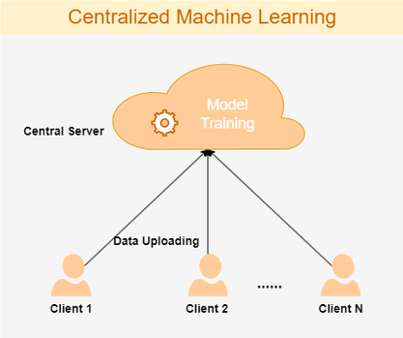
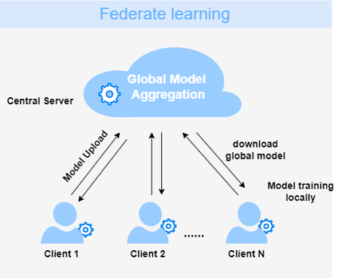
Traditional Machine Learning vs Federated Learning

Slide 4
Feature | Traditional Machine Learning | Federated Learning
Data Storage | Centralized (Cloud or Data Center) | Decentralized (On local devices)
Data Privacy | Raw data is uploaded to a server | Raw data never leaves the device
Model Training | Trained on one large, combined dataset | Trained locally on many small datasets
Communication | High bandwidth (sending raw data) | Low bandwidth (sending model updates)
Compliance | Harder to meet GDPR/HIPAA rules | Built-in compliance and security
Use Case | Big data analytics, weather sensing | Predictive text, medical research, IoT

Slide 5
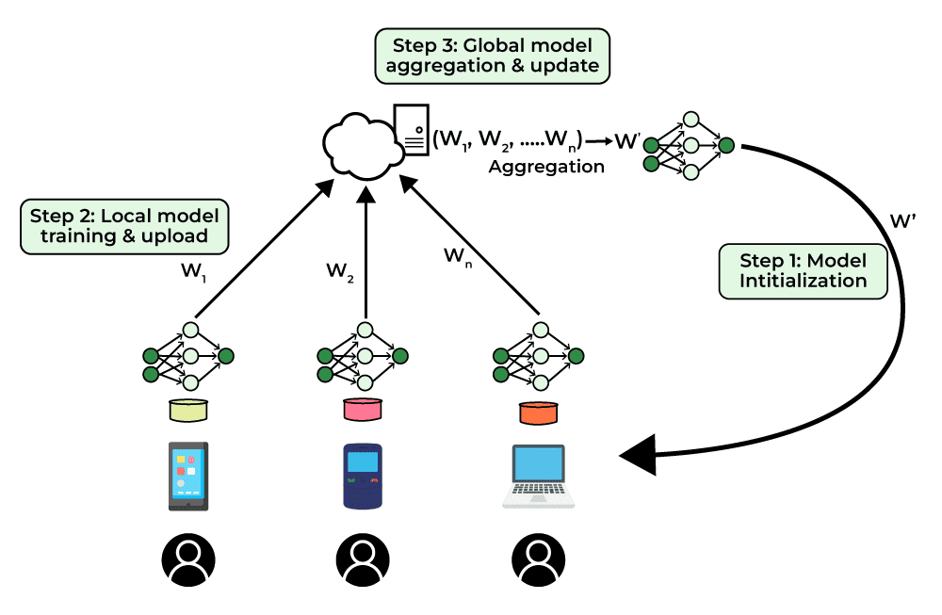
Federated Learning in depth
Server (Coordinator)
Maintains and updates the global model
Selects clients for each training round
Sends model to clients & aggregates updates
Never accesses raw data
Clients (Edge Devices)
Examples: smartphones, hospitals, banks, IoT devices
Train model on local private data
Send only model updates (weights) to server
Data stays on device

Slide 6

Training Workflow
Step 1: Initialize Model
Server initializes global model $W_{0}$
Sets round counter $t=0$
Step 2: Select Clients
Random subset of clients chosen (≈10–30%)
Others remain idle
Step 3: Broadcast Model
Server sends current model $W_{t}$to selected clients
(Often compressed to reduce communication cost)

Slide 7
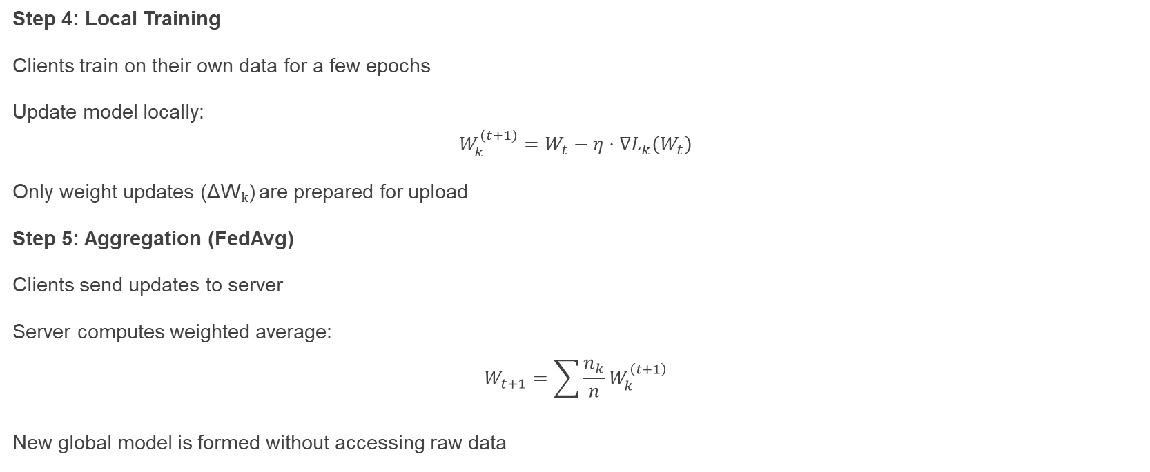
Training Workflow
Step 4: Local Training
Clients train on their own data for a few epochs
Update model locally: $W_{k}^{\left(t+1\right)}=W_{t}−η⋅∇L_{k}\left(W_{t}\right)$
Only weight updates (ΔWₖ) are prepared for upload
Step 5: Aggregation (FedAvg)
Clients send updates to server
Server computes weighted average: $W_{t+1}=\sum{\frac{n_{k}}{n}}W_{k}^{\left(t+1\right)}$
New global model is formed without accessing raw data

Slide 8
Training Variants
1. Synchronous FL
All selected clients finish training before aggregation
More stable, but slower
2. Asynchronous FL
Server updates whenever a client sends updates
Faster but less stable

Slide 9
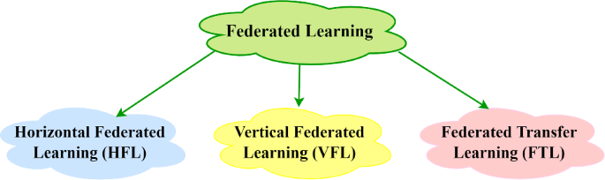
Types of Federated Learning

Slide 10
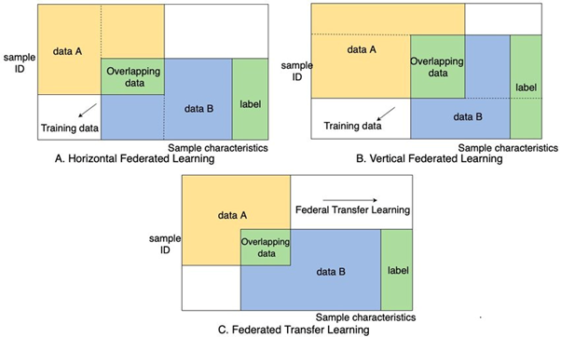
Types of Federated Learning
1. Horizontal Federated Learning
Same feature space, different users
Example: Mobile keyboards across users
2. Vertical Federated Learning
Same users, different features
Example: Bank + e-commerce sharing encrypted features
3. Federated Transfer Learning
Different users + different features
Uses transfer learning techniques

Slide 11
Real-World Applications
Healthcare
Hospitals collaboratively train models without sharing patient data.
Finance
Banks detect fraud without exposing sensitive customer data.
Mobile Devices
Predictive keyboards
Voice recognition
Next-word prediction
Real-Life Application of Federated Learning: Google Keyboard
Data Collection: Google Keyboard (Gboard) collects data, like the names of restaurants you search for, but keeps it on your phone. Your personal data never leaves your device.

Slide 12
Advantages of Federated Learning
Reduced Power Usage: Reduced data size means reduced computation time and hence less power usage.
Guarantees Privacy: Data stays on the device, maintaining privacy without loss of training.
No Device Performance Impact: Training is done only when the device is in idle or charging state, hence no impact on performance.
Scalability: Scales with big, distributed datasets across multiple devices.
Better Model Performance: Uses heterogeneous data from various devices to improve model accuracy.
Real-time Updates: Allows real-time model updates on each device.

Slide 13
Disadvantages of Federated Learning
Network Latency: The communication between the devices and the central server can be a bottleneck and may add latency to the training process.
Heterogeneous devices: The devices can be heterogeneous in terms of hardware and software, which can make it difficult to ensure the compatibility and consistency of the models.
Data Quality: The quality of data can vary across the devices, which can lead to poor model performance.

Slide 14
References
1. https://cloud.google.com/discover/what-is-federated-learning
2. https://www.researchgate.net/figure/Classification-of-federated-learning-in-10-a-Horizontal-federated-learning-HFL_fig1_378809686
3. https://onlinelibrary.wiley.com/doi/10.1155/2021/8261663
4. https://www.youtube.com/watch?v=89BGjQYA0uE
5. https://www.geeksforgeeks.org/machine-learning/collaborative-learning-federated-learning/
6. https://media.springernature.com/lw685/springer-static/image/chp%3A10.1007%2F978-981-95-3543-9_21/MediaObjects/654870_1_En_21_Fig1_HTML.png
7. https://media.springernature.com/lw685/springer-static/image/art%3A10.1007%2Fs10115-024-02257-6/MediaObjects/10115_2024_2257_Fig8_HTML.png

Slide 15
Thank You

